Slide 1
Calorie/Weight Management
Jamaine Cotton Jibril Stewart

Slide 2
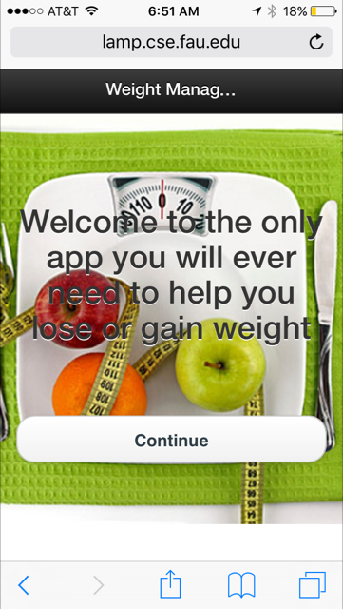
App Introduction

Slide 3
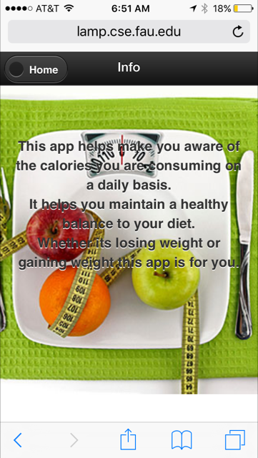

Slide 4
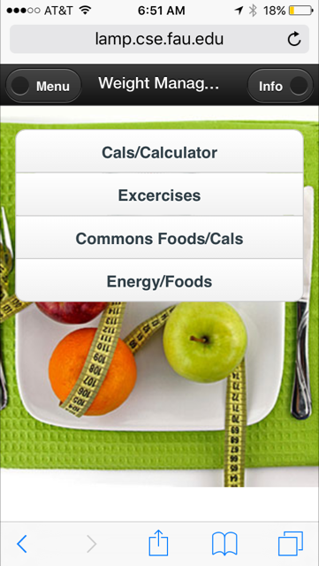
Menu Page
The choices of tabs we have available to better help you obtain the knowledge for good weight management.

Slide 5
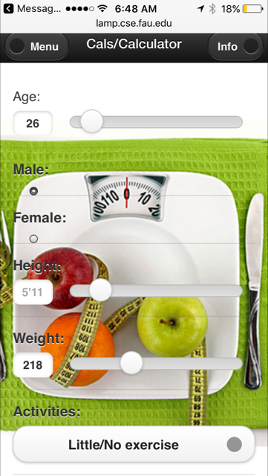
BMR(Basal Metabolic Rate) Calculation page
This tab calculates your (BMR) Basal Metabolic Rate. Using the info you input. Such as your height, age, weight, gender and the intensity of your weekly activities. Once calculated there will be a reference to the amount of calories needed to lose/gain weight based on the calculated BMR

Slide 6
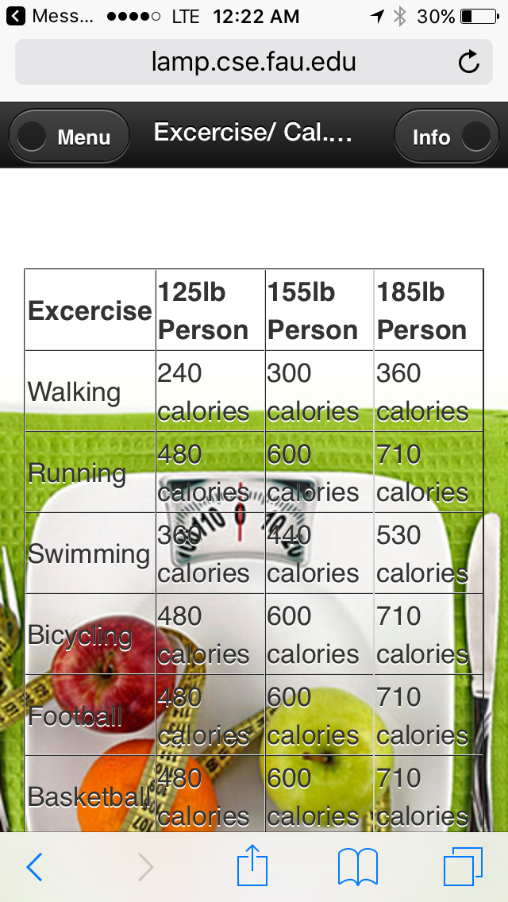
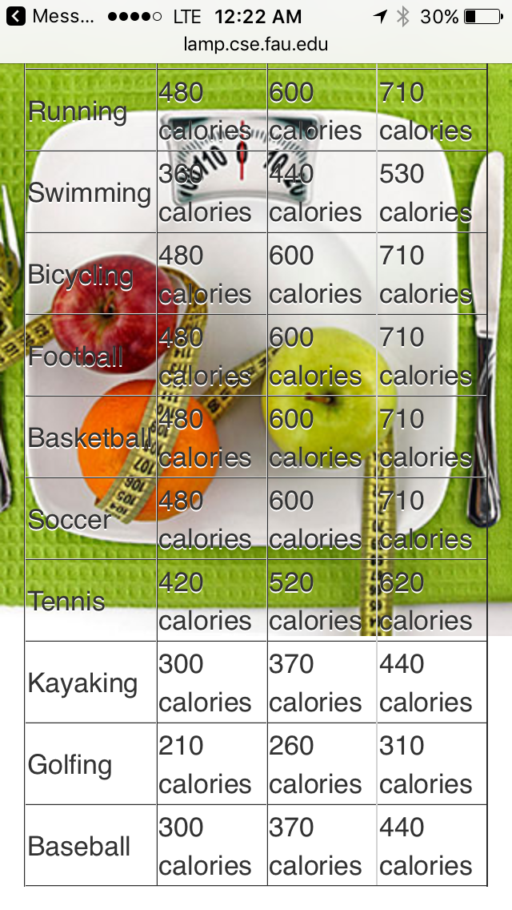
Exercises/Calorie Burn
Provided is this table giving an example of a few exercises and the calories they burn based on your weight.

Slide 7
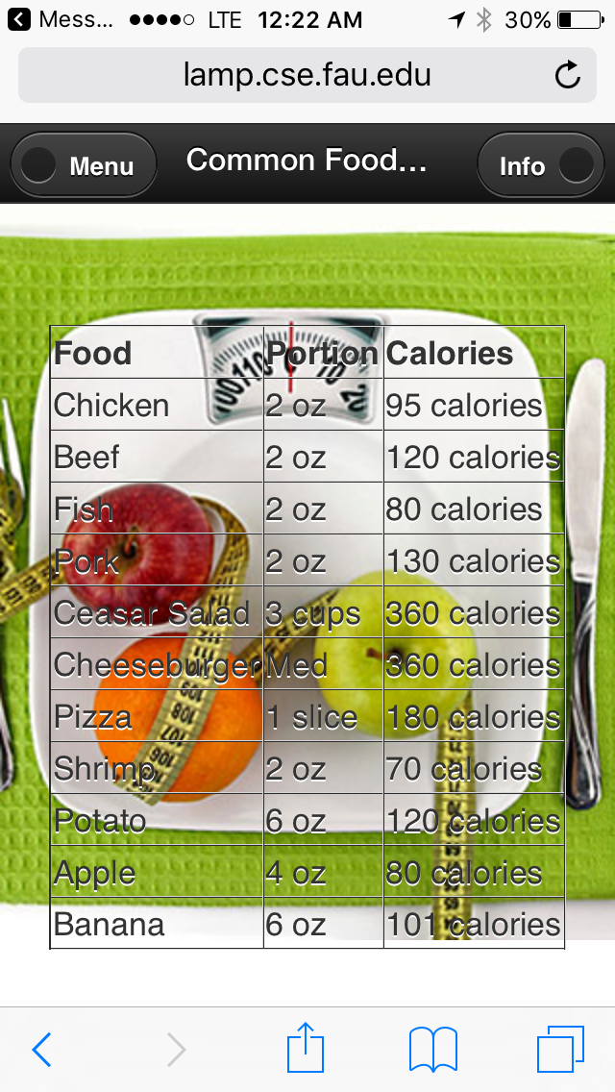
Common Foods
A short list of common foods consumed on a daily bases for some. Along with the average amounts of calories with the portions for each item.

Slide 8
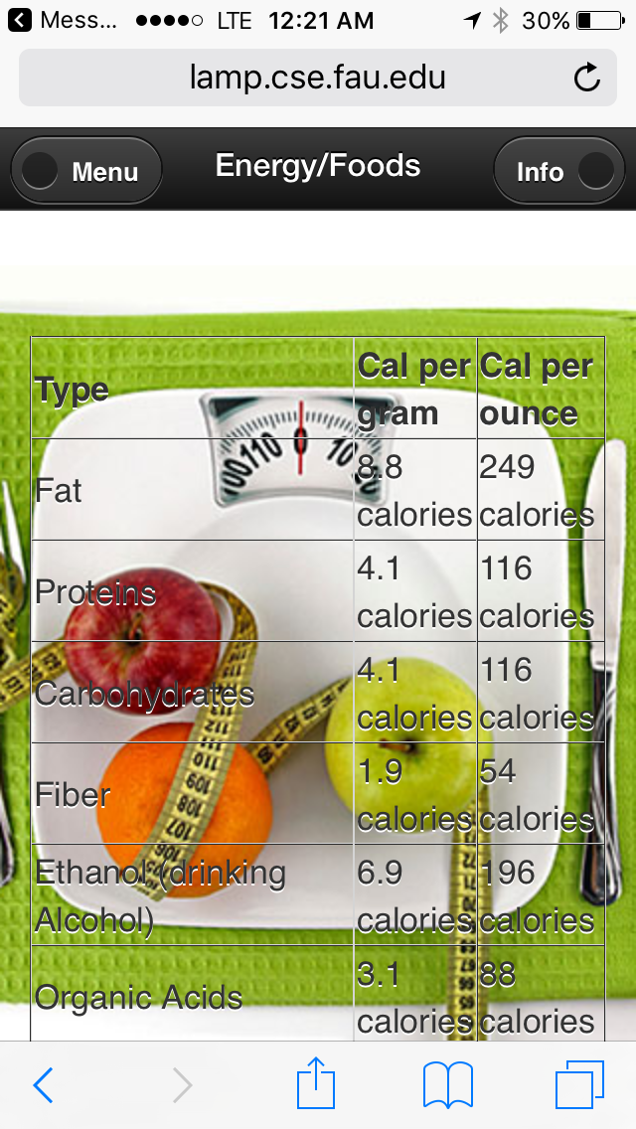
Energy/Foods
Used to maintain a good metabolism and muscle function. The table also provides a list of the type of foods and the energy each provides the body for the best result in activities.

Slide 9
Reference Page
http://lamp.cse.fau.edu/~jstewa50/classProjectApp/
http://www.wikihow.com/Calculate-Your-Total-Daily-Calorie-Needs
https://en.wikipedia.org/wiki/Food_energy
http://www.calculator.net/calorie-calculator.html
appetite_control_460 image retrieved from site below:
http://nutrition21.com/item/appetite-control-weight-management/
Github link: https://github.com/ckstewart/Weight-Management/tree/master/projectAssignments
Building Cross-Platform Mobile and Web Apps for Engineers and Scientist

